Slide 1
State Pattern

Slide 2
Design Patterns
Structural design patterns
Concerned with the way disparate objects can be connected to form larger complex systems. Simplifies relationship between entities.
Ex: Flyweight Pattern, Proxy
Behavioral design patterns
Concerned with interaction i.e. communication between objects
Ex: State Pattern
Creational design patterns
Concerned with the way objects are created
Tries to reduce tight coupling between classes
Ex: Factory Pattern, Singleton Pattern

Slide 3
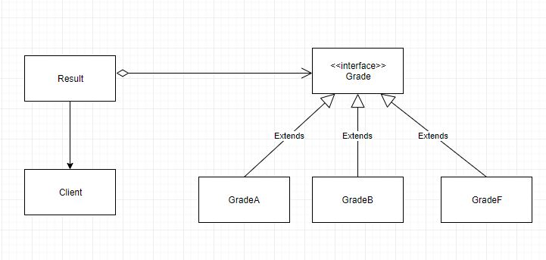
State Pattern
Object changes its behavior when its internal state changes.

Slide 4
Pros
Easy to add more states for additional behavior
Easy to maintain
Helps avoid if/else or switch/case conditional logic

Slide 5
References
https://www.journaldev.com/1751/state-design-pattern-java
https://www.baeldung.com/java-state-design-pattern
https://refactoring.guru/design-patterns/state

